Slide 1

NAME:HOSANNA ISA
MATRIC NO:CSC/24U/4494
TITLE:SIWES EXPERIENCE AT N.I.T.D.A
FACULTY:COMPUTING
DEPT:COMPUTER SCIENCE
LEVEL:300
SIWES:12 WEEKS

Slide 2


PLACE OF SIWES: N.I.T.D.A
LOCATION: GOMBE,GOMBE STATE NIGERIA
COURSE ENROLLED:WEB DEVELOPMENT

Slide 3
WEB DEVELOPMENT PROJECT

Slide 4
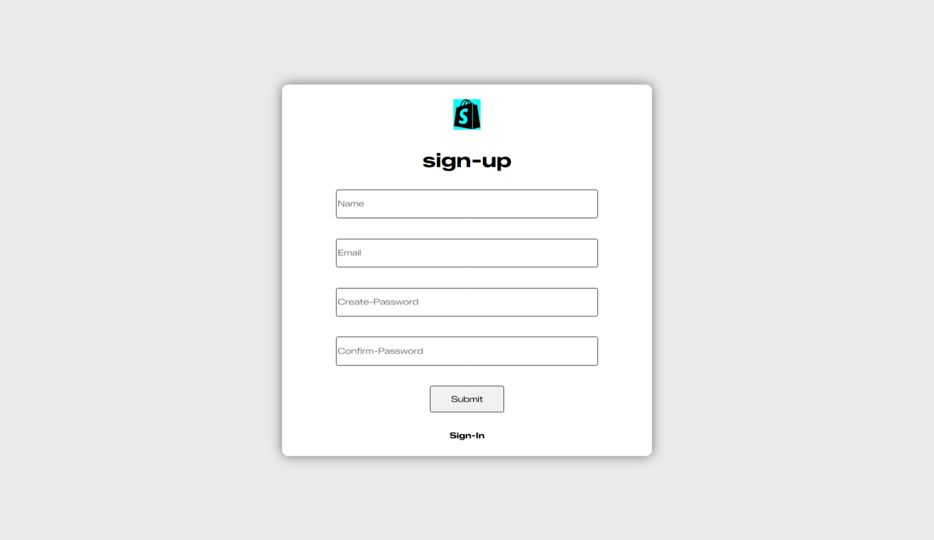
SIGN UP PAGE

Slide 5
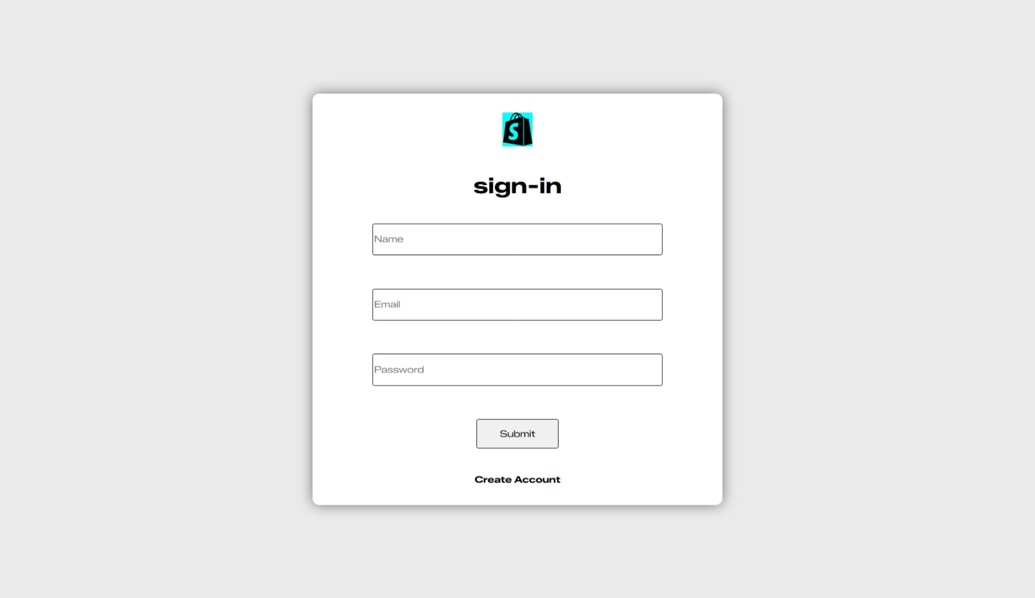

SIGN IN PAGE
WEB DEVELOPMENT PROJECT

Slide 6
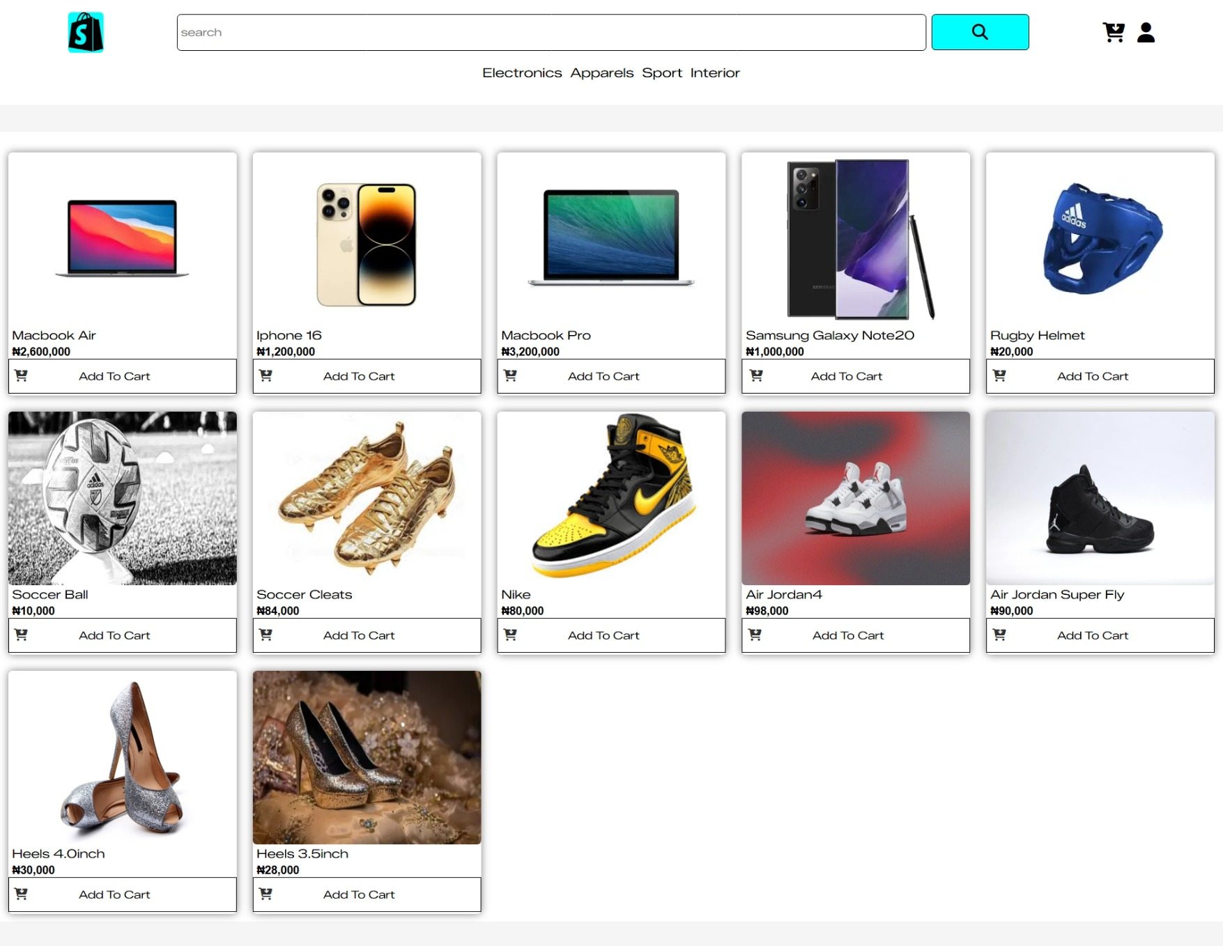
HOME PAGE

Slide 7
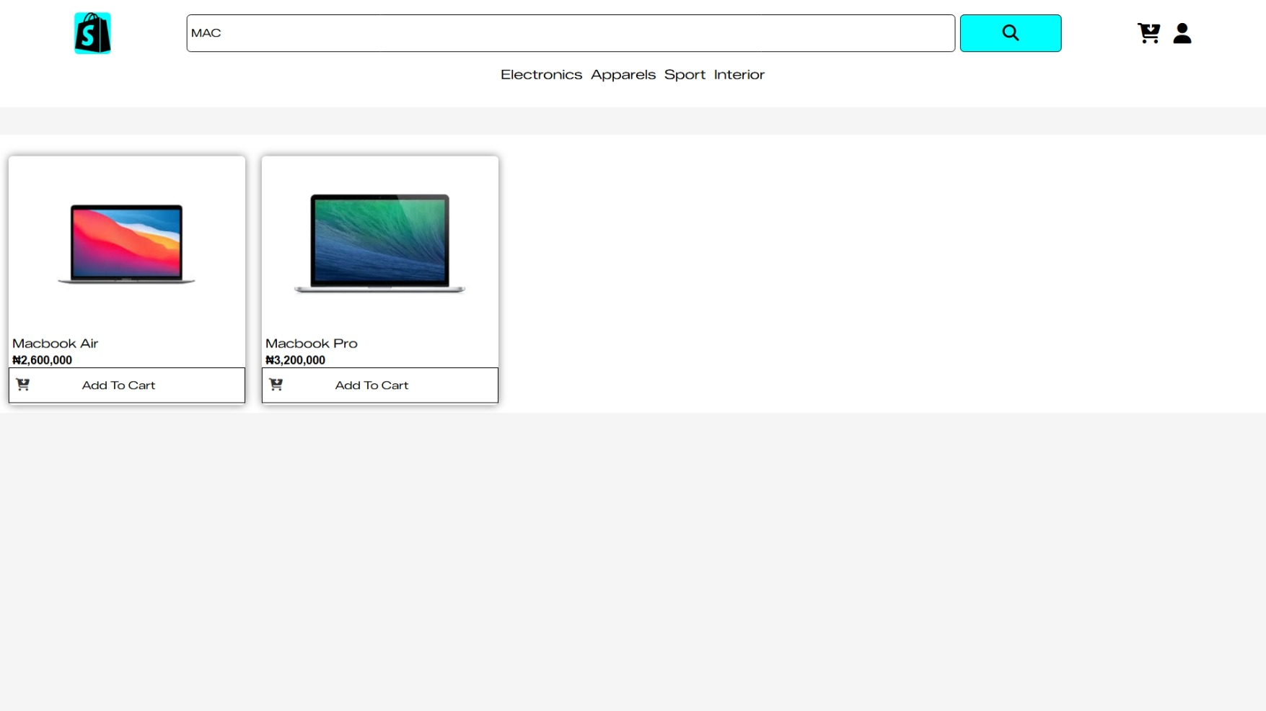
SEARCH FEATURE DEMONSTRATION

Slide 8
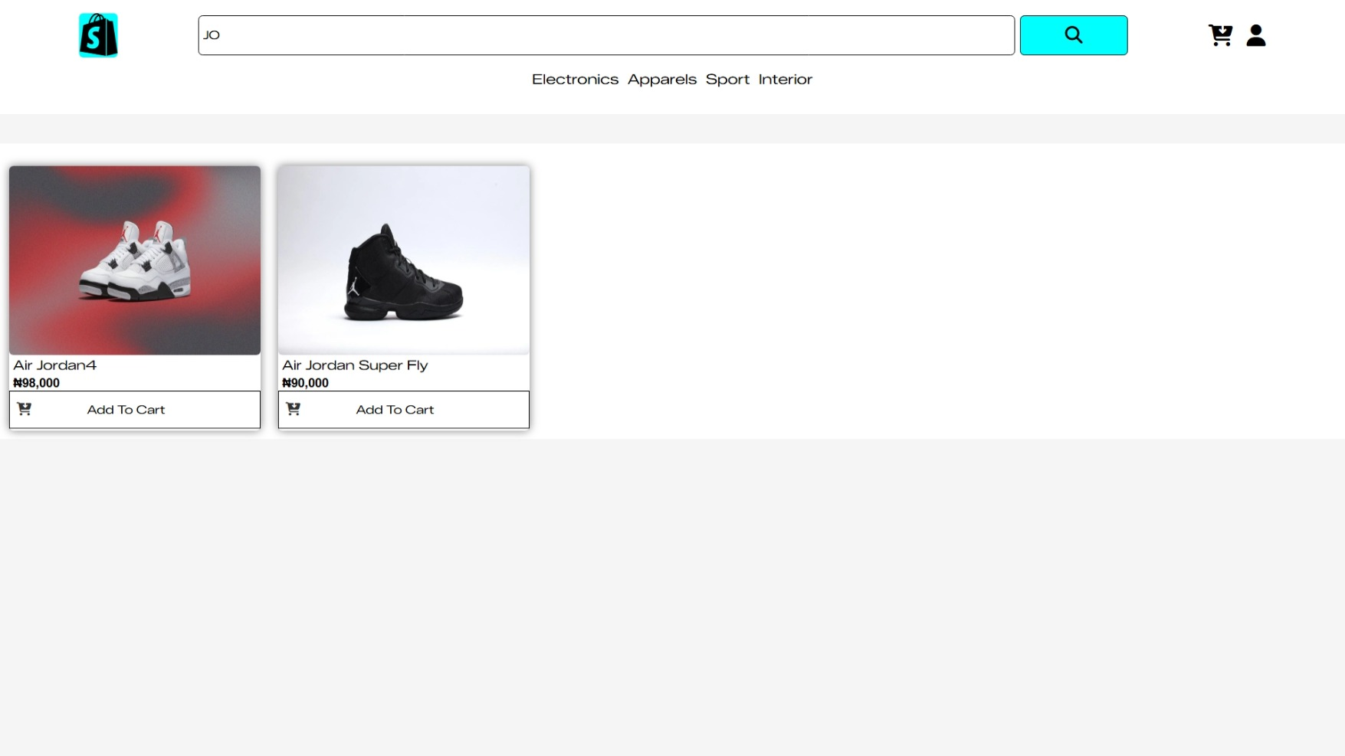
SEARCH FEATURE DEMONSTRATION 2

Slide 9
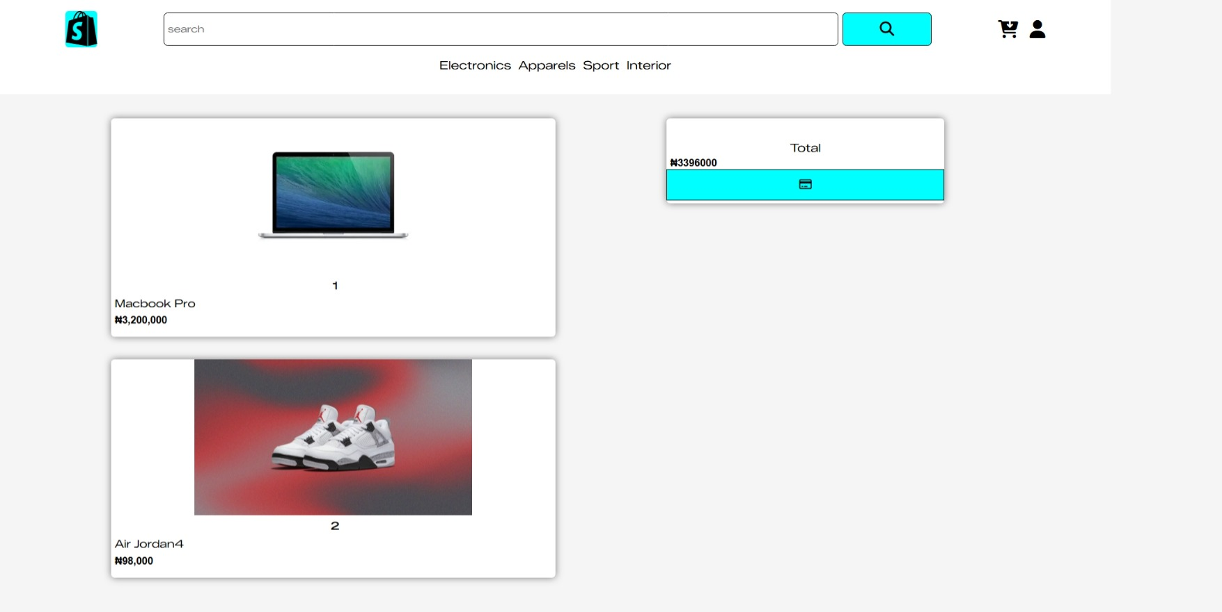
CART PAGE

Slide 10
CHALLENGES FACED

Slide 11
SEARCH ALGORITHM

Slide 12
SEARCH ALGORITHM IMPLEMENTATION IN JAVASCRIPT

Slide 13
THE END, THANKS FOR LISTENING

